Slide 1
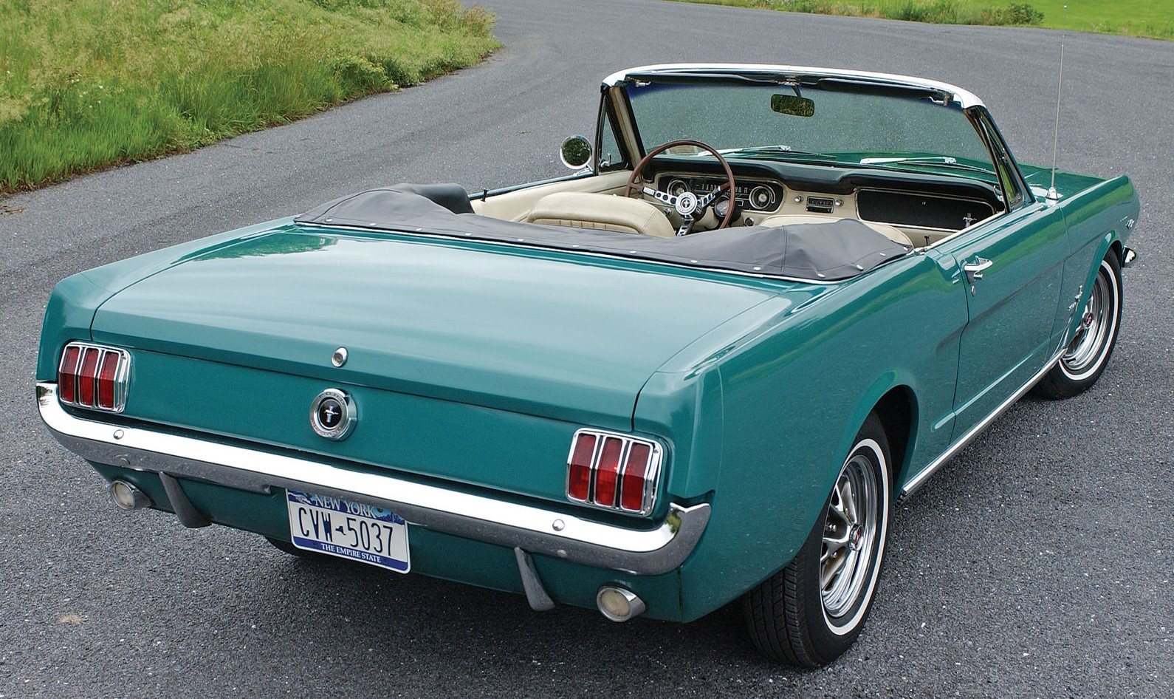
Heap Sort: J. W. J. Williams in 1964
Kurt Friedrich Spring 2016

Slide 2
http://www.comp.dit.ie/rlawlor/Alg_DS/sorting/heap%20sort.pdf
You may have noticed that in a max heap, the largest value can easily be removed from the top of the heap
Then we promote the bottom most, right most node to the top (and let it Cascade down to where it belongs)
But, a 'free' slot is made available where that bottom node was.
If you take the prior largest value, and store it in this new empty slot, over and over again, we would have a sorted array.
This suggests the basis of a new sorting algorithm, namely Heap Sort

Slide 3
2 things going on:
Start with a data in an array, and just “declare it” to now be a Heap ⬅ and then fix it, to in fact be a valid heap.
Treat the entire array as 2 arrays. The unsorted Heap, and the sorted array:

Slide 4
Heapsort algorithm can be divided into 2 parts.
Stage 1: map the data into a proper max-heap* array structure as we covered earlier in the course. We can transform an unordered array into a heap in linear time. O (n)
Stage 2: divide the array into a sorted and an unsorted region, and then iteratively shrink the unsorted region by extracting the smallest element and moving that to the sorted region. When all the elements have been moved out of the heap into the sorted segment, you have a finished sorted array.
Like merge sort, the worst case time of heap sort is O(n log n)
* Max heap will yield sort with lowest value at index 0, use min heap for largest value at index 0

Slide 5
But to use a heap to sort and array, you must first convert the array to a heap.
There are 2 approaches to “heapify” an array:
[1] A top-down approach: we insert array values one at a time into a heap initially consisting of the first array value.
https://www.youtube.com/watch?v=WYII2Oau_VY
https://www.youtube.com/watch?v=6NB0GHY11Iw

Slide 6
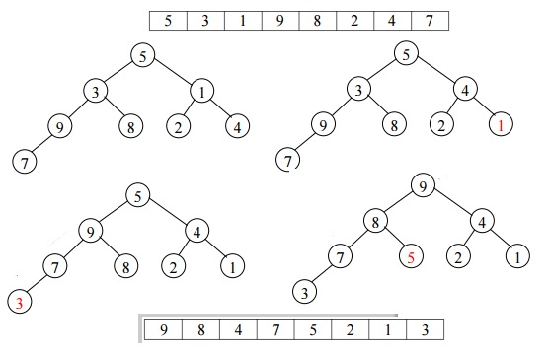
2nd approach to “heapify” an array
A bottom up approach: we start at what should be the most bottom node that has a child, and “fix it” if it needs to be fixed, and then move up the array one spot (which is the next upper parent node) and do it again, and again …

Slide 7
Reference sites:
http://www.personal.kent.edu/~rmuhamma/Algorithms/MyAlgorithms/Sorting/heapSort.htm
http://en.wikipedia.org/wiki/Heapsort
http://cis.stvincent.edu/html/tutorials/swd/heaps/heaps.html

Slide 8
Create a heap. Bottom-up or top-down?
On Sep 3, 2:27 am, Aarti <aarti.sa...@gmail.com> wrote: > >
In heapsort we first create a heap using heapify. There are 2 ways of creating
the heap. Bottom-up and top-down. Can someone tell me which one is more
efficient and why should we prefer one over another.
This question actually has quite an interesting answer. The top-down heapify
(originally described by Williams) generally speaking, has a lower higher_{klf}
Instruction count than the bottom-up heapify (originally described by Floyd). In
fact, building a heap top-down takes O(n lg n) worst case time, whereas bottom
Up takes only O(n) worst case time. As a result, all algorithms text-books
recommend Floyd's approach. However, Williams's algorithm is generally
much faster in practice, despite the fact that it almost always executes
more instructions. This is because it has much better spatial locality
than Floyd's algorithm (i.e. it causes far fewer cache misses). So, on modern
processors, Williams's top-down heapify is the algorithm of choice. …
Nicholas Nash http://www.netsoc.tcd.ie/~nash

Slide 9

http://cis.stvincent.edu/html/tutorials/swd/heaps/heaps.html
Stage 1:
Start with array
First convert to a heap (using FilterDown approach)
Go to the index of the last parent node. This is given by (HeapSize - 2) / 2. (also have seen this as (HeapSize - 1) / 2, either seems to work, guessing that integer roundoff explains this. klf)
In this case, (9 - 2) / 2 = 3. Thus K is the last parent in the tree.
We then apply the FilterDown routine to each node from this index down to index 0. (Note that this is each node from 3 down to 0, not just the nodes along the path from index 3 to index 0. So, K, C, S, P, not just K, S, P)
In our example, the array corresponds directly to the following binary tree which is not yet a heap.
P
/ \
S C
/ \ / \
K M L A
/ \
X E

Slide 10
Apply filter down at Index 3, which was K
P
/ \
S C
/ \ / \
E M L A
/ \
X K
Note that E is the smaller child under K.
Apply filter down at Index 2, which was C
P
/ \
S A
/ \ / \
E M L C
/ \
X K
Under C, A is the smaller child.

Slide 11
Apply filter down at Index 1, which was S
P
/ \
E A
/ \ / \
K M L C
/ \
X S
Check the smaller child, E, and then the smaller child under that, namely K. Both E and K get moved up.
Apply filter down at Index 2, which was C
A
/ \
E C
/ \ / \
K M L P
/ \
X S
Finally, filter down at index 0, the root node. We check the smaller child, A, and then the smaller child, C, relative to the target P. Both A and C get moved up.
Stage 1 is done, we have a proper min-heap!

Slide 12
Stage 2: divide the array into a sorted and an unsorted region, and then iteratively shrink the unsorted region by extracting the smallest element and moving that to the sorted region.
Repeatedly [1] remove the root item, [2] adjust the heap, and then [3] put the removed item in the now empty slot toward the end of the array that had been the heap.
Remove the A, adjust the heap by using FilterDown at the root node, and place the A at the back of the array in what used to be the last position before we removed the root.

Slide 13
A
E
C
K
L
M
P
X
S
[1] remove the root item
C
/ \
E L
/ \ / \
K M S P
/
X
A
[2] adjust the heap
[3] put the removed item in the now empty slot
C
E
L
K
M
S
P
X
A
Heap
Sorted Array

Slide 14
2nd move
C
E
L
K
M
S
P
X
A
[1] remove the root item
C
E
/ \
K L
/ \ / \
X M S P
[2] adjust the heap
[3] put the removed item in the now empty slot
E
K
L
X
M
S
P
C
A
Heap
Sorted Array

Slide 15
Them do it over and over until the heap is empty
X
K
L
X
M
S
P
C
A
[1] remove the root item
X
[2] adjust the heap
empty
/ \
[3] put the removed item in the now empty slot
X
S
P
M
L
K
E
C
A
Sorted Array

Slide 16
Looking at our code, which works on ints
p 16
s 19
c 3
k 11
m 13
l 12
a 1
x 24
e 5
x 24
s 19
p 16
m 13
l 12
k 11
e 5
c 3
a 1

Slide 17
Look at the code to see how it is implemented
4-HeapSortSol

Slide 18
Performance of Heap Sort
Quicksort is typically somewhat faster due to some factors, but the worst-case running time for quicksort is O(n²), which is unacceptable for large data sets and can be deliberately triggered given enough knowledge of the implementation, creating a security risk.
Because of the O(n log n) upper bound on heapsort's running time and constant upper bound on its auxiliary storage, embedded systems with real-time constraints or systems concerned with security often use heapsort.
Heapsort also competes with merge sort, which has the same time bounds. Merge sort requires Ω(n) auxiliary space, but heapsort requires only a constant amount.
Ω(n) (Big Omega of n) means it will take at least twice as long for a list that is twice as big.
O(n) means that it'll take at most twice as long for a list twice as big
If an implementation is both O(n) and Ω(n), then it can be said to be Θ(n) (Big Theta of n), meaning that it'll take exactly twice as long if there are twice as many elements.
Heapsort typically runs faster in practice on machines with small or slow data caches. On the other hand, merge sort has several advantages over heapsort:
Merge sort on arrays has considerably better data cache performance, often outperforming heapsort on modern desktop computers because merge sort frequently accesses contiguous memory locations (good locality of reference); heapsort references are spread throughout the heap.
Merge sort is stable, while heapsort is not a stable sort;
Merge sort parallelizes well with a trivial implementation; heapsort is not an obvious candidate for a parallel algorithm.
Merge sort is used in external sorting; heapsort is not. Locality of reference is the issue.

Slide 19
Building our random array
Start by writing 1 thru n into array locations [0] thru [n-1]
This creates the set of values we want to randomize.
Then loop, counting down from [n-1] element, swapping the values between
The current element and the random one.
Write this value into one of 1 thru 5 , and swap that value into here
1
Write this value into one of 1 thru 4 , and swap that value into here
2
3
Write this value into one of 1 thru 3 , and swap that value into here
4
Write this value into one of 1 thru 2 , and swap that value into here
5
No reason for last entry since it will swap 0 with 0

